Slide 1
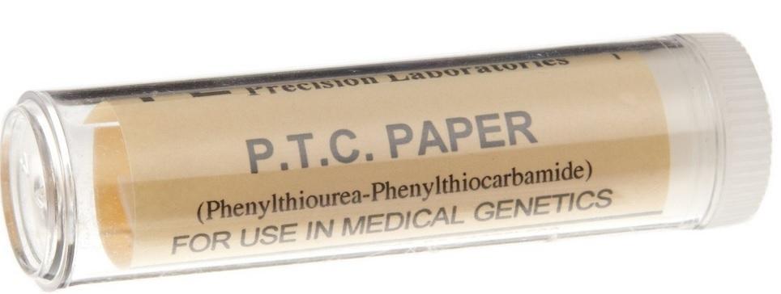
PTC Taste Test LAB

Slide 3
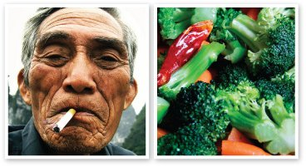
Studies indicate that individuals with the "strong tasters" PTC gene variant were less likely to be smokers. This may indicate that people who find PTC bitter are more likely than non-tasters to find the taste of cigarettes bitter and may be less likely to smoke.
Other studies suggest that there may be correlations between the ability to taste PTC and preferences for certain types of foods. This may be why some of us think that broccoli is just too bitter to eat.

Slide 4
